Slide 1
Dev IDE and POM Settings for code check

Slide 2
Tools list
For every pull request pushed to EdgeGallery projects, we will run some code compliance verification tests against the code.
Tools used in EdgeGallery pull request compliance verification and can be integrated in Dev env.:
CheckStyle (Java IDE + POM)
PMD (Java - POM)
FindBugs (Java - POM )
Sonarqube - (java - sonarlint IDE)
ESLint (Java Script / Vue)
golangci-lint (golang)
Coverity - CI
Notes:
https://gitee.com/edgegallery/community/blob/master/Security%20WG/Tutorials/Gitee%20Pull%20Request%20Compliance%20Verification.md

Slide 3
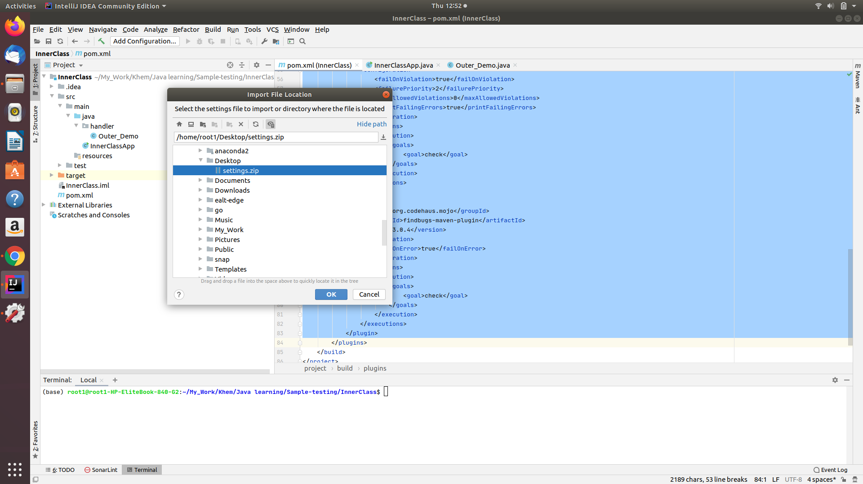
CheckStyle in IntelliJ IDE
1. Import below google java code style(modified 2 rules) into project.
https://drive.google.com/drive/u/0/folders/13cWe7Y8Co4f8_j8wcF7Uv2TkiKjvRalU
2. In settings->Editor->Code Style, Select “google style” and apply
3. On project, select “refactore code (ctrl+Alt+L)”
4. This will fix code style issues as per settings 5. Update Pom file for checkstyle, PMD and findbugs
6. Do “mvn clean install” and confirm/fix issues if any
7. Run “mvn tidy:pom” for pom xml formatting
8. Sonar lint, goto Analyzer->”Analyse all files with sonarlint”

Slide 4
CheckStyle POM setting
<project>
...
<build>
<plugins>
<plugin>
<groupId>org.apache.maven.plugins</groupId>
<artifactId>maven-checkstyle-plugin</artifactId>
<version>3.1.1</version>
<configuration>
<consoleOutput>true</consoleOutput>
<failOnViolation>true</failOnViolation>
<violationSeverity>warning</violationSeverity>
<configLocation>
https://raw.githubusercontent.com/EdgeGallery/infra/master/configs/edgegallery_checks.xml
</configLocation>
</configuration>
<executions>
<execution>
<goals>
<goal>check</goal>
</goals>
</execution>
</executions>
</plugin>
</plugins>
</build>
...
</project>
EdgeGallery projects use Google Java Style with 2 modifications:
4.2 Block indentation: +4 spaces
4.4 Column limit: 120
https://github.com/EdgeGallery/infra/blob/master/configs/edgegallery_checks.xml. All ‘warning’ severity level is considered a violation.
set the plugin in the section of your POM as below:

Slide 5
PMD POM setting
<project>
...
<build>
<plugins>
<plugin>
<groupId>org.apache.maven.plugins</groupId>
<artifactId>maven-pmd-plugin</artifactId>
<version>3.13.0</version>
<configuration>
<failOnViolation>true</failOnViolation>
<failurePriority>2</failurePriority>
<maxAllowedViolations>0</maxAllowedViolations>
<printFailingErrors>true</printFailingErrors>
</configuration>
<executions>
<execution>
<goals>
<goal>check</goal>
</goals>
</execution>
</executions>
</plugin>
</plugins>
</build>
...
</project>
PMD is a static source code analyzer. It finds common programming flaws like unused variables, empty catch blocks, unnecessary object creation, and so forth. PMD is able to detect flaws or possible flaws in source code, like:
Possible bugs—Empty try/catch/finally/switch blocks.
Dead code—Unused local variables, parameters and private methods.
Empty if/while statements.
Overcomplicated expressions—Unnecessary if statements, for loops that could be while loops.
Suboptimal code—Wasteful String/StringBuffer usage.
Classes with high Cyclomatic Complexity measurements.
Duplicate code—Copied/pasted code can mean copied/pasted bugs, and decreases maintainability.
All PMD violations with priority level 1 (most severe) and 2 are required to be fixed
set the plugin in the section of your POM as below:
PMD Java rules: https://pmd.github.io/latest/pmd_rules_java.html

Slide 6
FindBugs POM setting
FindBugs uses static analysis to inspect Java bytecode for occurrences of bug patterns.
All FindBugs warnings are required to be fixed
set the plugin in the section of your POM as below:
FindBugs Bug descriptor: http://findbugs.sourceforge.net/bugDescriptions.html
<project>
...
<build>
<plugins>
<plugin>
<groupId>org.codehaus.mojo</groupId>
<artifactId>findbugs-maven-plugin</artifactId>
<version>3.0.4</version>
<configuration>
<failOnError>true</failOnError>
</configuration>
<executions>
<execution>
<goals>
<goal>check</goal>
</goals>
</execution>
</executions>
</plugin>
</plugins>
</build>
...
</project>

Slide 7
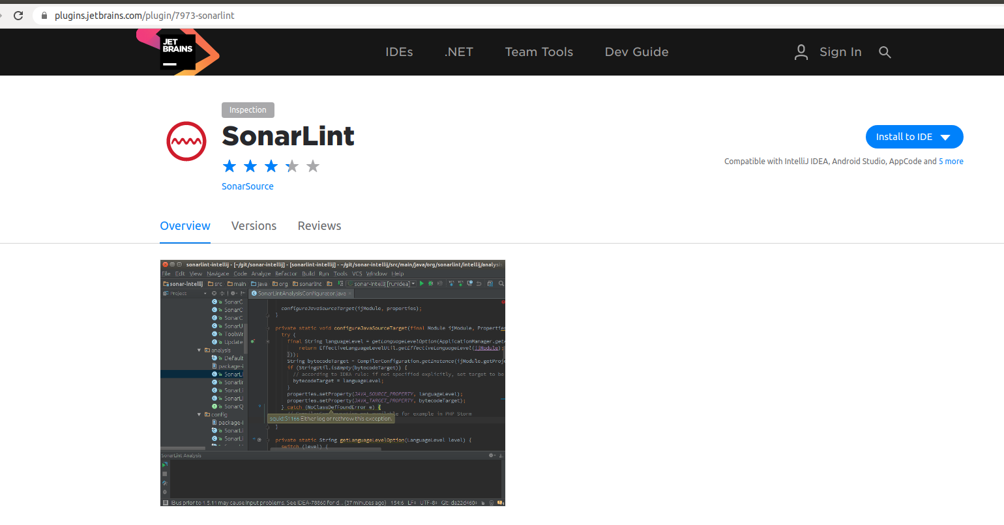
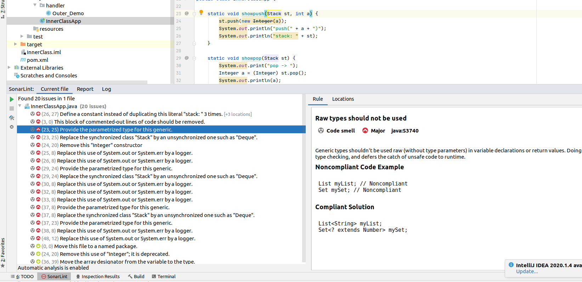
Sonarlint in IntelliJ
https://www.sonarlint.org/
To install sonarlint plugin to IntelliJ, install by below link:
https://plugins.jetbrains.com/plugin/7973-sonarlint
Run Sonar lint: goto Analyzer->”Analyse all files with sonarlint”
View SonarLint: in sonarlint windows, check each file and error description in parallel windows

Slide 8
ESLint
...
"scripts": {
...
"eslint": "eslint -f checkstyle --ext .js,.vue src -o eslint_result.xml"
...
},
...
"devDependencies": {
...
"eslint": "^5.16.0",
"eslint-plugin-vue": "^5.2.3",
...
},
"eslintConfig": {
"root": true,
"env": {
"node": true
},
"extends": [
"plugin:vue/base",
"plugin:vue/essential",
"plugin:vue/strongly-recommended",
"@vue/standard"
],
"rules": {},
"parserOptions": {
"parser": "babel-eslint"
}
},
...
ESLint is a tool for identifying and reporting on patterns found in ECMAScript/JavaScript code, with the goal of making code more consistent and avoiding bugs.
eslint-plugin-vue is the official ESLint plugin for Vue.js.
EdgeGallery uses eslint-plugin-vue base rules, essential rules and strongly-recommended rules.
All issues are required to be fixed
To run ESLint, add the following content in your package.json file:
To explicitly execute the ESLint and generate a report, execute the following CLI in your local development environment:
$ npm install
$ npm run esint
Reference
eslint-plugin-vue rules: https://eslint.vuejs.org/rules/

Slide 9
golangci-lint
Install golangci-lint in your local development environment:$ curl -sSfL https://raw.githubusercontent.com/golangci/golangci-lint/master/install.sh | sh -s -- -b $(go env GOPATH)/bin v1.30.0
Go to the source code directory and run golangci-lint:
$ cd <source_code_dir>
$ golangci-lint run --out-format checkstyle > golangci.xml
GoLand IDE
If you are using GoLand IDE, you can install and use the Go Linter plugin directly.
Go format for checkstyle --- check with security team wheather it can be used alongwith of Go linter
To explicitly execute the ESLint and generate a report, execute the following CLI in your local development environment:
$ npm install
$ npm run esint

Slide 10
Coverity scan - low priority for IDE
Currently run in CI
Need backend server to process**

Slide 11
<plugin>
<groupId>org.apache.maven.plugins</groupId>
<artifactId>maven-checkstyle-plugin</artifactId>
<version>3.1.1</version>
<configuration>
<consoleOutput>true</consoleOutput>
<failOnViolation>true</failOnViolation>
<violationSeverity>warning</violationSeverity>
<configLocation>
https://raw.githubusercontent.com/EdgeGallery/infra/master/configs/edgegallery_checks.xml
</configLocation>
</configuration>
<executions>
<execution>
<goals>
<goal>check</goal>
</goals>
</execution>
</executions>
</plugin>
<plugin>
<groupId>org.apache.maven.plugins</groupId>
<artifactId>maven-pmd-plugin</artifactId>
<version>3.13.0</version>
<configuration>
<failOnViolation>true</failOnViolation>
<failurePriority>2</failurePriority>
<maxAllowedViolations>0</maxAllowedViolations>
<printFailingErrors>true</printFailingErrors>
</configuration>
<executions>
<execution>
<goals>
<goal>check</goal>
</goals>
</execution>
</executions>
</plugin>
<plugin>
<groupId>org.codehaus.mojo</groupId>
<artifactId>findbugs-maven-plugin</artifactId>
<version>3.0.4</version>
<configuration>
<failOnError>true</failOnError>
</configuration>
<executions>
<execution>
<goals>
<goal>check</goal>
</goals>
</execution>
</executions>
</plugin>
Combined POM settings for Checkstyle+PMD+Findbugs

Slide 12
Thanks

